Slide 1
Health Disparities for Chicago Public Housing Residents
Kyto Batt, Sarah Biagi, and Seth Flynn

Slide 2
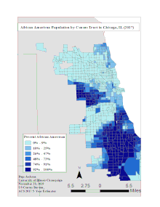
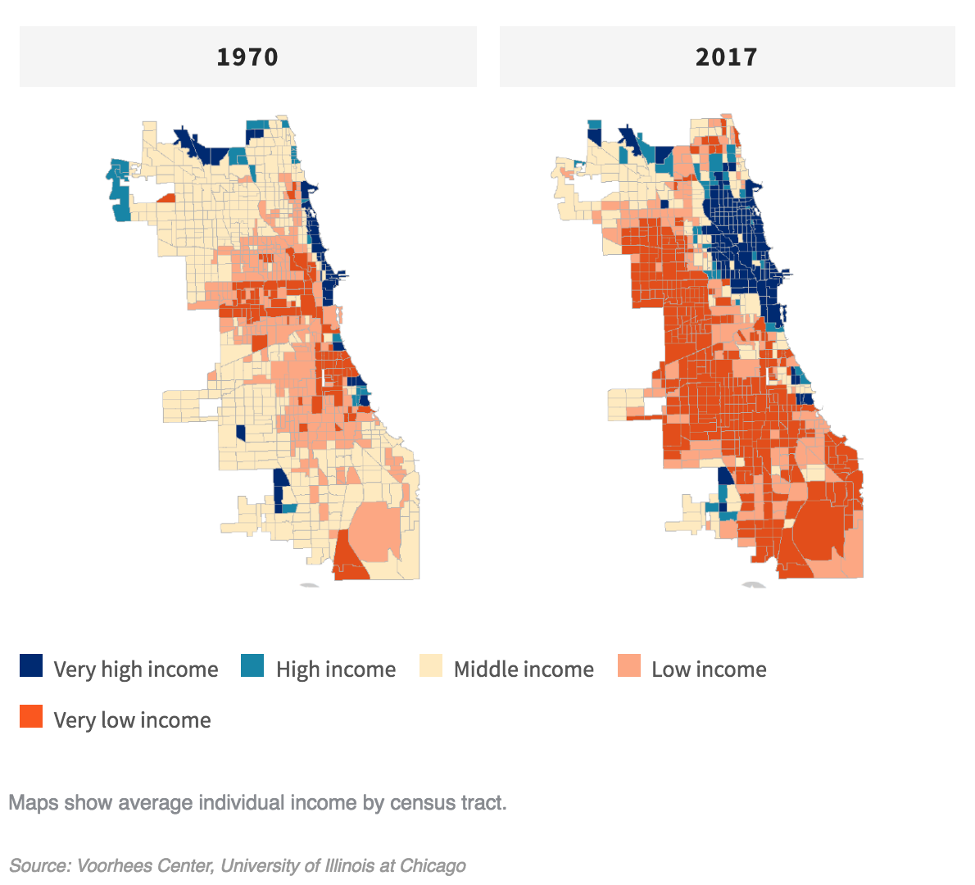
Background
Chicago neighborhoods are largely divided by race and class
Inequality is high
Disinvestment in public housing over time
Poor infrastructure

Slide 3
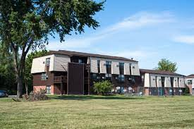
Chicago
Public Housing and HUD
Developments located on the South and West sides
Have less infrastructure
Higher rates of health issues for public housing residents in Chicago
Worsened by lack of resources and access
Mold, insects, peeling paint, bad roofing, plumbing and electrical issues, etc

Slide 4
Policy Options

Slide 5
Reallocate the Budget
Chicago has a very large budget
Small percentage of Chicago’s budget is used toward public housing
Public housing facilities need repairs and upgrades
Old facilities
Occupied by vulnerable residents

Slide 6
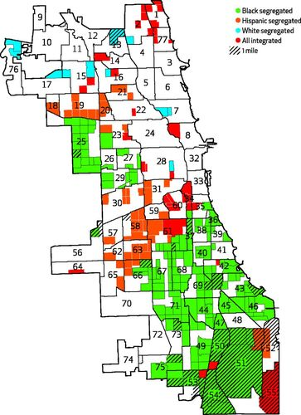
Urban Deserts
Lack of transportation near many housing developments
Limited access to healthcare services and pharmacies
Image Credit: ‘Pharmacy Deserts’ Are Prevalent In Chicago’s Predominantly Minority Communities, Raising Medication Access Concerns
Dima M. Qato, Martha L. Daviglus, Jocelyn Wilder, Todd Lee, Danya Qato, and Bruce Lambert
Health Affairs 2014 33:11, 1958-1965

Slide 7
Policy Recommendation

Slide 8
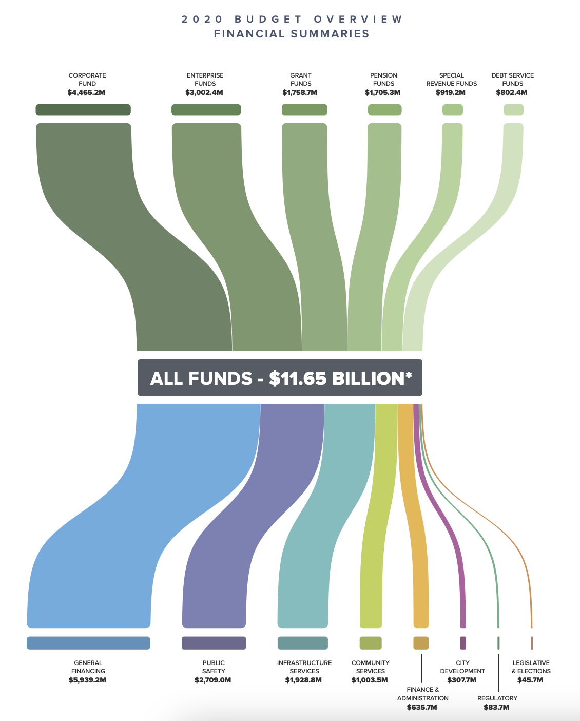
Reallocate the Budget
Creating new transportation is costly and difficult
Public housing needs more funding!
Decrease police budget
Shift public health budget to increase funds for public housing initiatives
Shift housing budget to increase funds for public housing developments

Slide 9
Thank You!

Slide 10
References
Chicago Housing Authority. “About.” About | The Chicago Housing Authority, 2021, www.thecha.org/about.
Theodos, Hangen, Meixell, and Rajasekaran. 2019. Neighborhood Disparities in Investment Flows in Chicago.
City of Chicago. 2020. Budget Overview
Chicago Housing Authority. 2020. Moving to Work Annual Plan.

