Slide 1
Racial Disparities in Exposure to Environmental Hazards
Sarah Graber, Greta Schorer, Matthew Rothman, and Juan Carlos Feraro

Slide 2
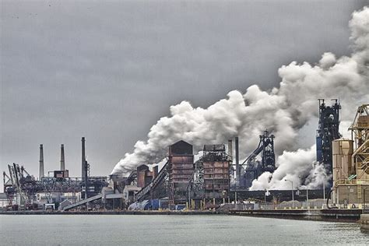
Background
Minority communities are more greatly affected by environmental hazards
History of redlining, lack of political power and “Not In My Backyard” arguments exposed Detroit residents to a greater proportion of environmental hazards
10-15 year average life expectancy difference
Stationary emittance from factories and mobile pollutants from highways are massive contributors
Climate crisis adversely affects those already exposed to environmental hazards

Slide 3
Policy Options
Using the Superfund Restoration Act to Fund Superfund Sites
Allocating funds for superfund sites located in minority communities
Use the Superfund Restoration Act to fund these goals and increase overall funding for the currently underfunded EPA program
Using Government Subsidies to Develop Green Energy
Increasing government focus on green energy development
Focusing subsidies for green energy specifically in low-income and minority communities

Slide 4
Recommendation
The policy option we recommend is focusing government subsidies in areas most affected by climate change and environmental injustice.
This option helps would assist in a move away from fossil fuels and the increased health, safety, and security that comes with green energy.
Carbon footprint reduction will reduce pollution and establish jobs that will spur lasting change in the city’s energy industry and give opportunities for stabilization of income.
Green subsidies are generally a politically attractive option that has the ability to be cost effective, especially when considering money saved from externalities and pollution.
This solution promotes residential advocacy, with instances of green solutions making citizens more inclined to promote shifts in behavior.

Slide 5
Summary
The threat of the climate crisis can only worsen the disparities within these communities.
This issue must be addressed through innovative and equitable policy solutions that can help to alleviate past environmental injustice and give communities affected a stake in their response to climate change.

Slide 6
Acknowledgements
We would like to thank Sandra Turner-Handy and Nicholas Leonard for meeting with us.

