Slide 1
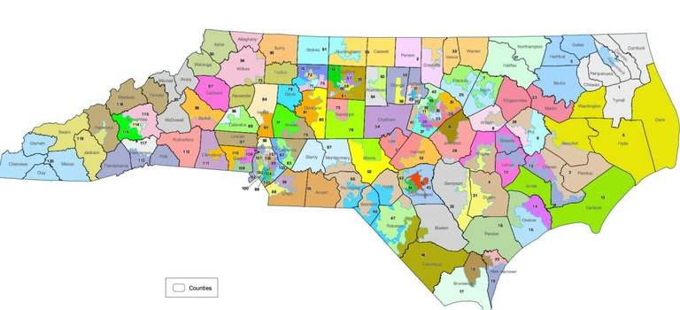
Gerrymandering and Health
Ethan Story, Vishnu Karthik, Stacy Rudolph, and Luke Albritton

Slide 2
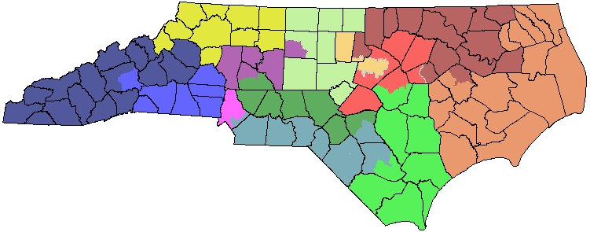
Background
Project REDMAP led to extremely gerrymandered districts
2020 vote % and seat % discrepancy
Notes:
North Carolina is one of many states with gerrymandered statehouse and congressional districts. Nearly a decade after North Carolina’s districts were unfairly redrawn under an initiative called Project REDMAP, North Carolina courts ordered the legislature to select a new map with more fairly drawn districts, but those new maps still reflected some degree of gerrymandering. In the 2020 election for the NC State House, Democrats received 49% of the vote but only 42.5% of House seats.

Slide 3
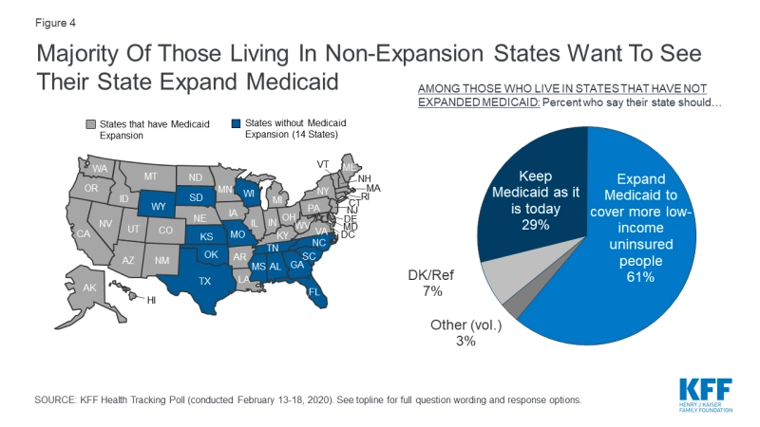
Background
NC Medicaid expansion could mean 350,000 more insured
More representative states have longer life expectancies
Notes:
This overt gerrymandering has far-reaching implications, including on healthcare access. Fourteen states have yet to expand Medicaid since the Affordable Care Act was passed, even though the majority of their residents support Medicaid expansion. And, if Medicaid expansion were to pass, over 350,000 more North Carolina residents could be insured. Nationwide analysis also shows that states with more representative legislative bodies have longer life expectancies on average. North Carolina should join these states, not only because it would ensure more fair representation, but also because it will improve the overall health of North Carolina residents.

Slide 4
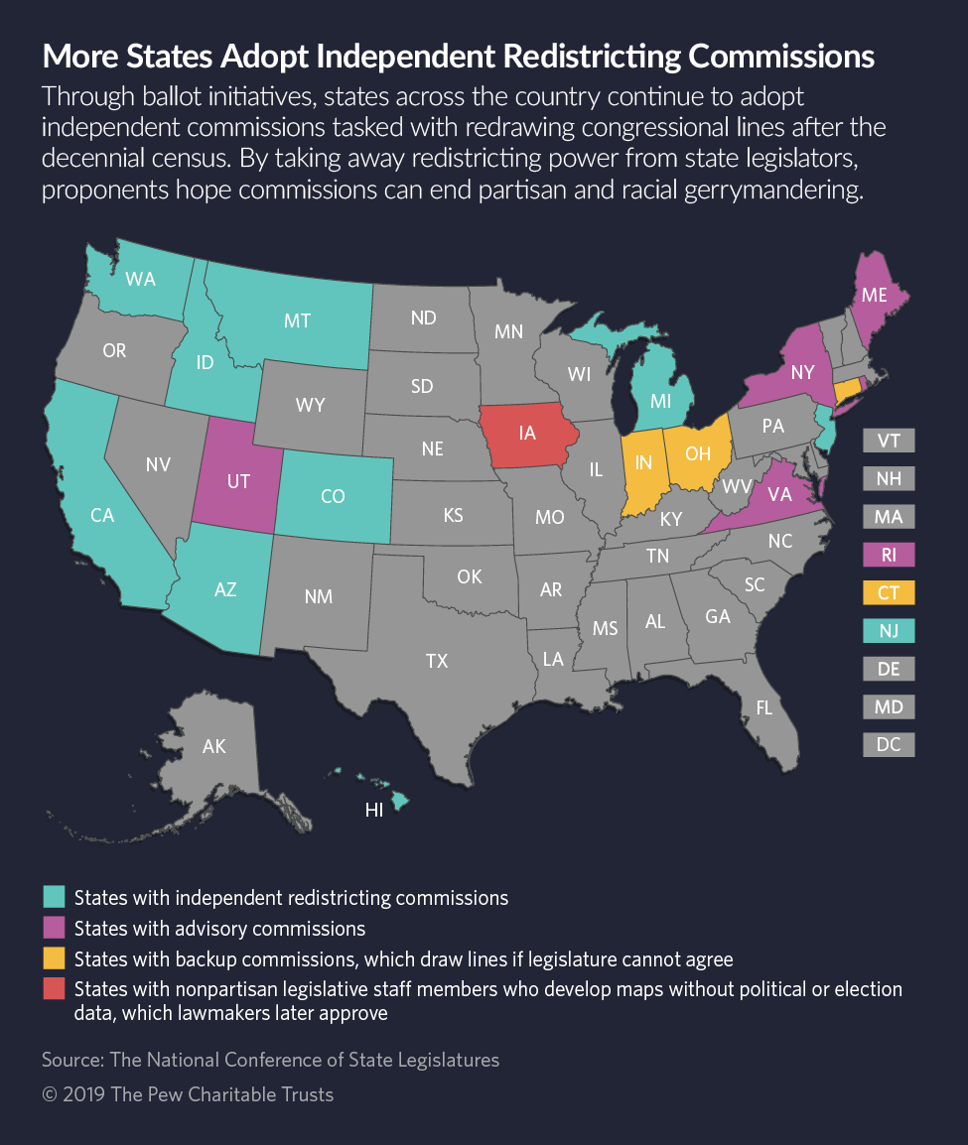
Independent Redistricting
Arizona became the first state to implement independent redistricting in 2000.
Overwhelmingly successful at making districts more competitive and representative.
States with legislatures that have less of a partisan bias and easier access to voting have higher life expectancies.
More competitive elections typically means more responsive public officials.
Notes:
Arizona’s most competitive districts became even more so while also adding extra competitive districts. During the 2011 redistricting scramble, at the state level, 80% of state legislature districts became more competitive post-redistricting

Slide 5
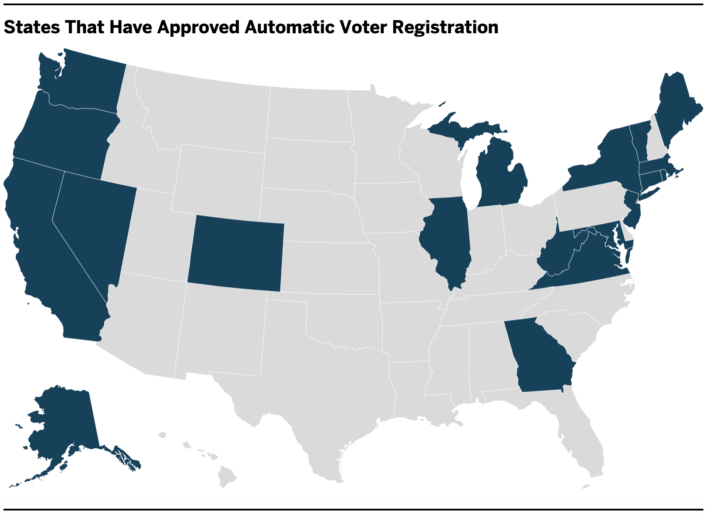
Automatic Voter Registration
Makes voter registration opt-out instead of opt-in
Would likely increase voter turnout

Slide 6
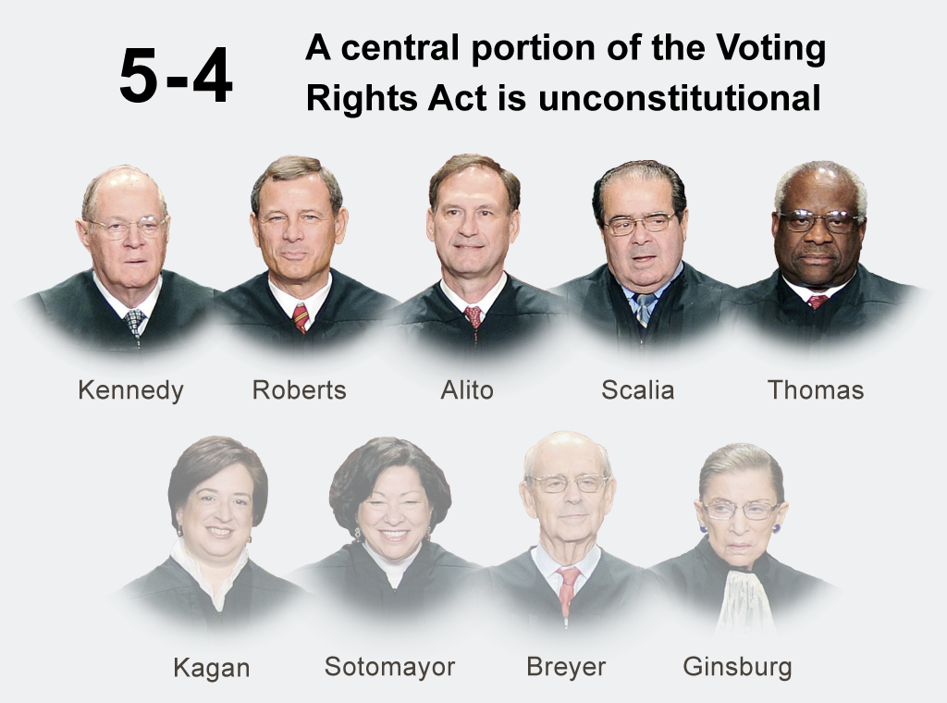
Restore the Voting Rights Act
Shelby County v. Holder (2013)
Has had a disastrous effect on voting rights

Slide 7
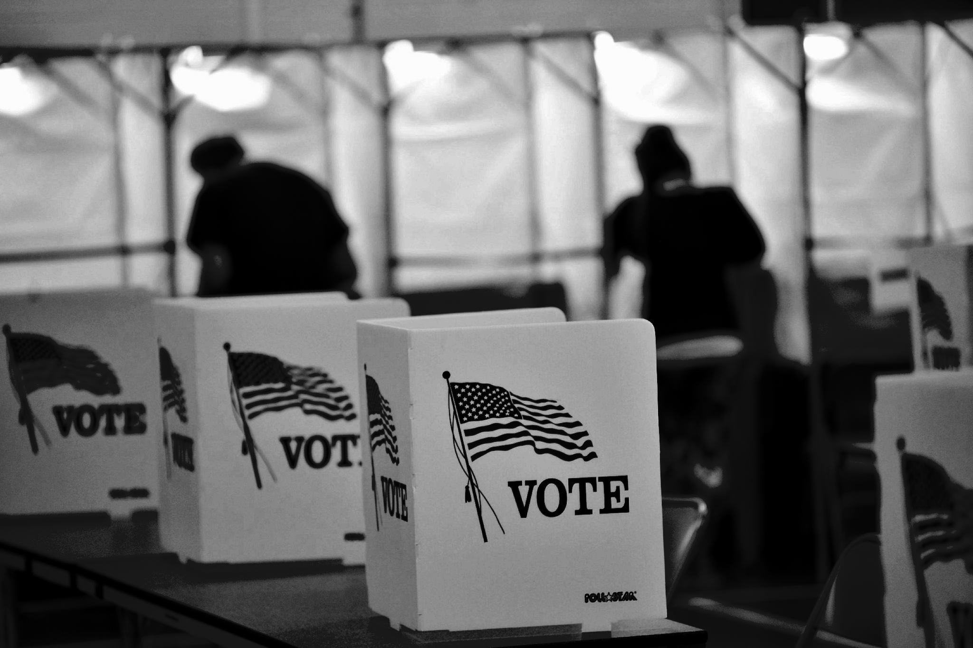
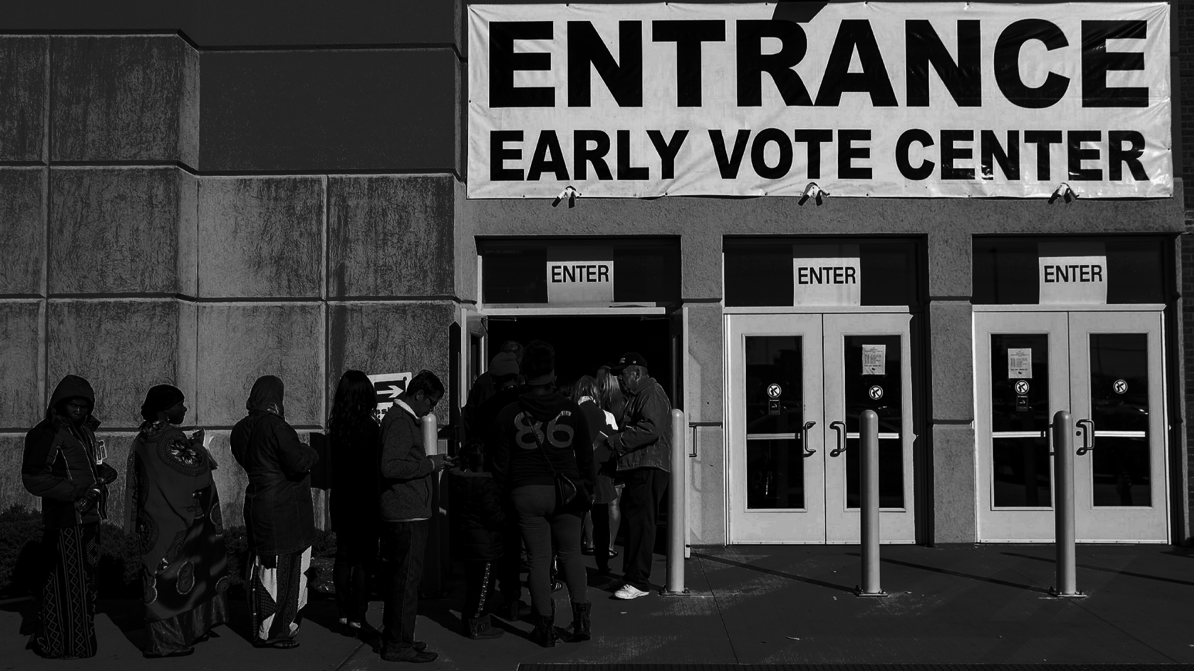
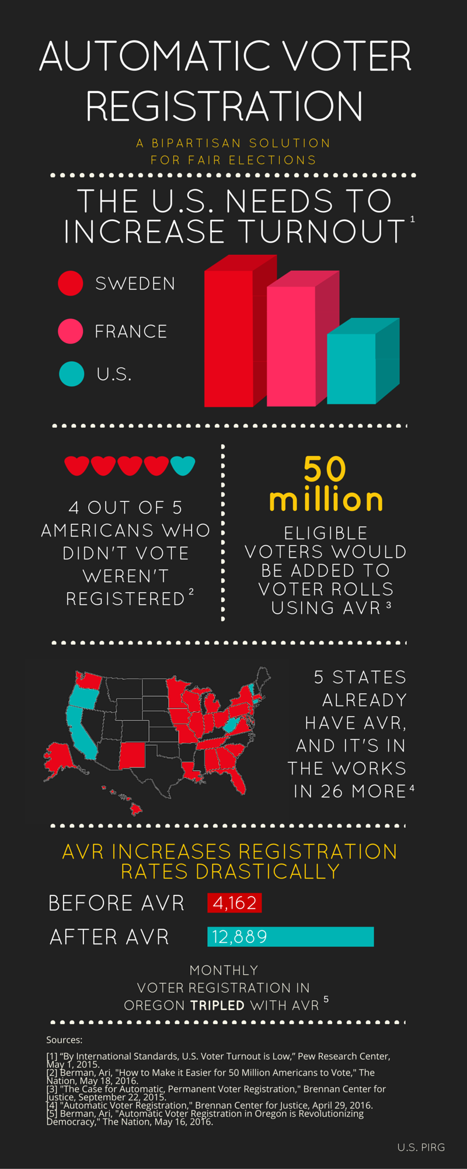
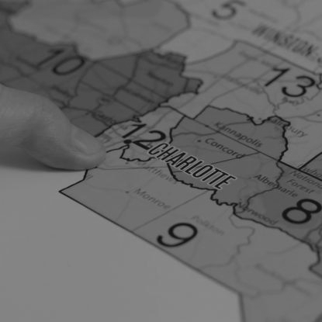
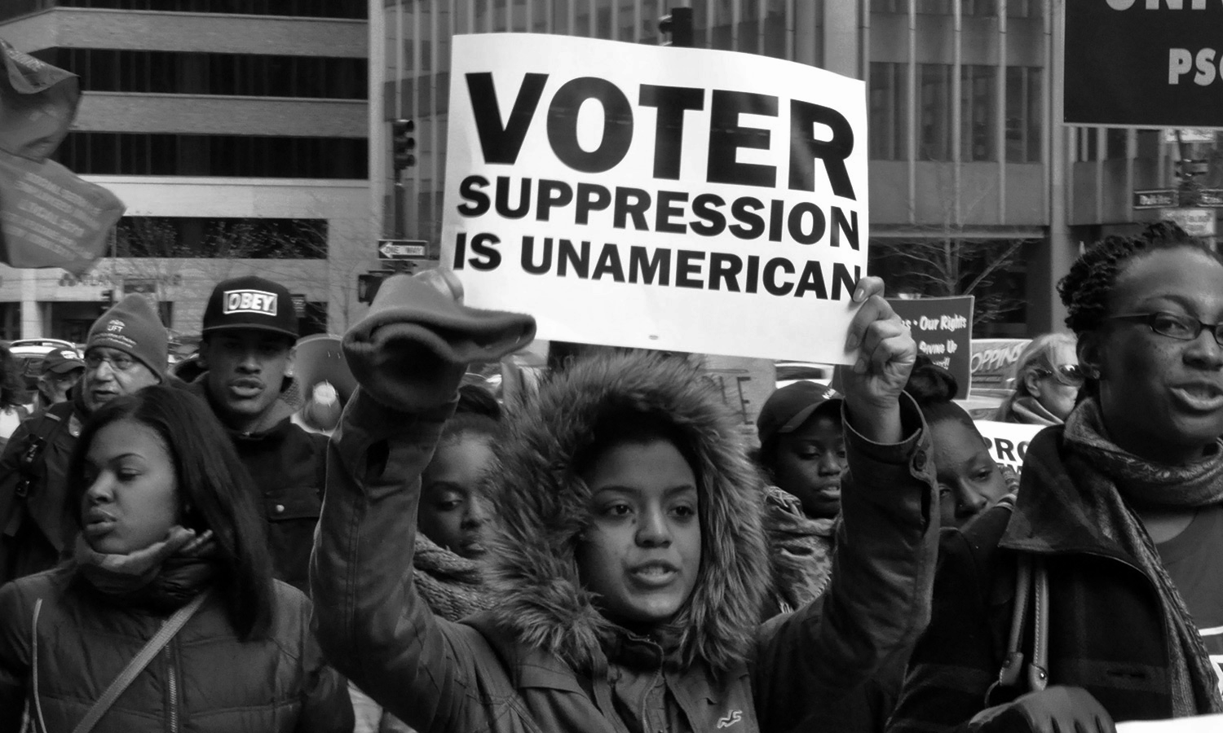
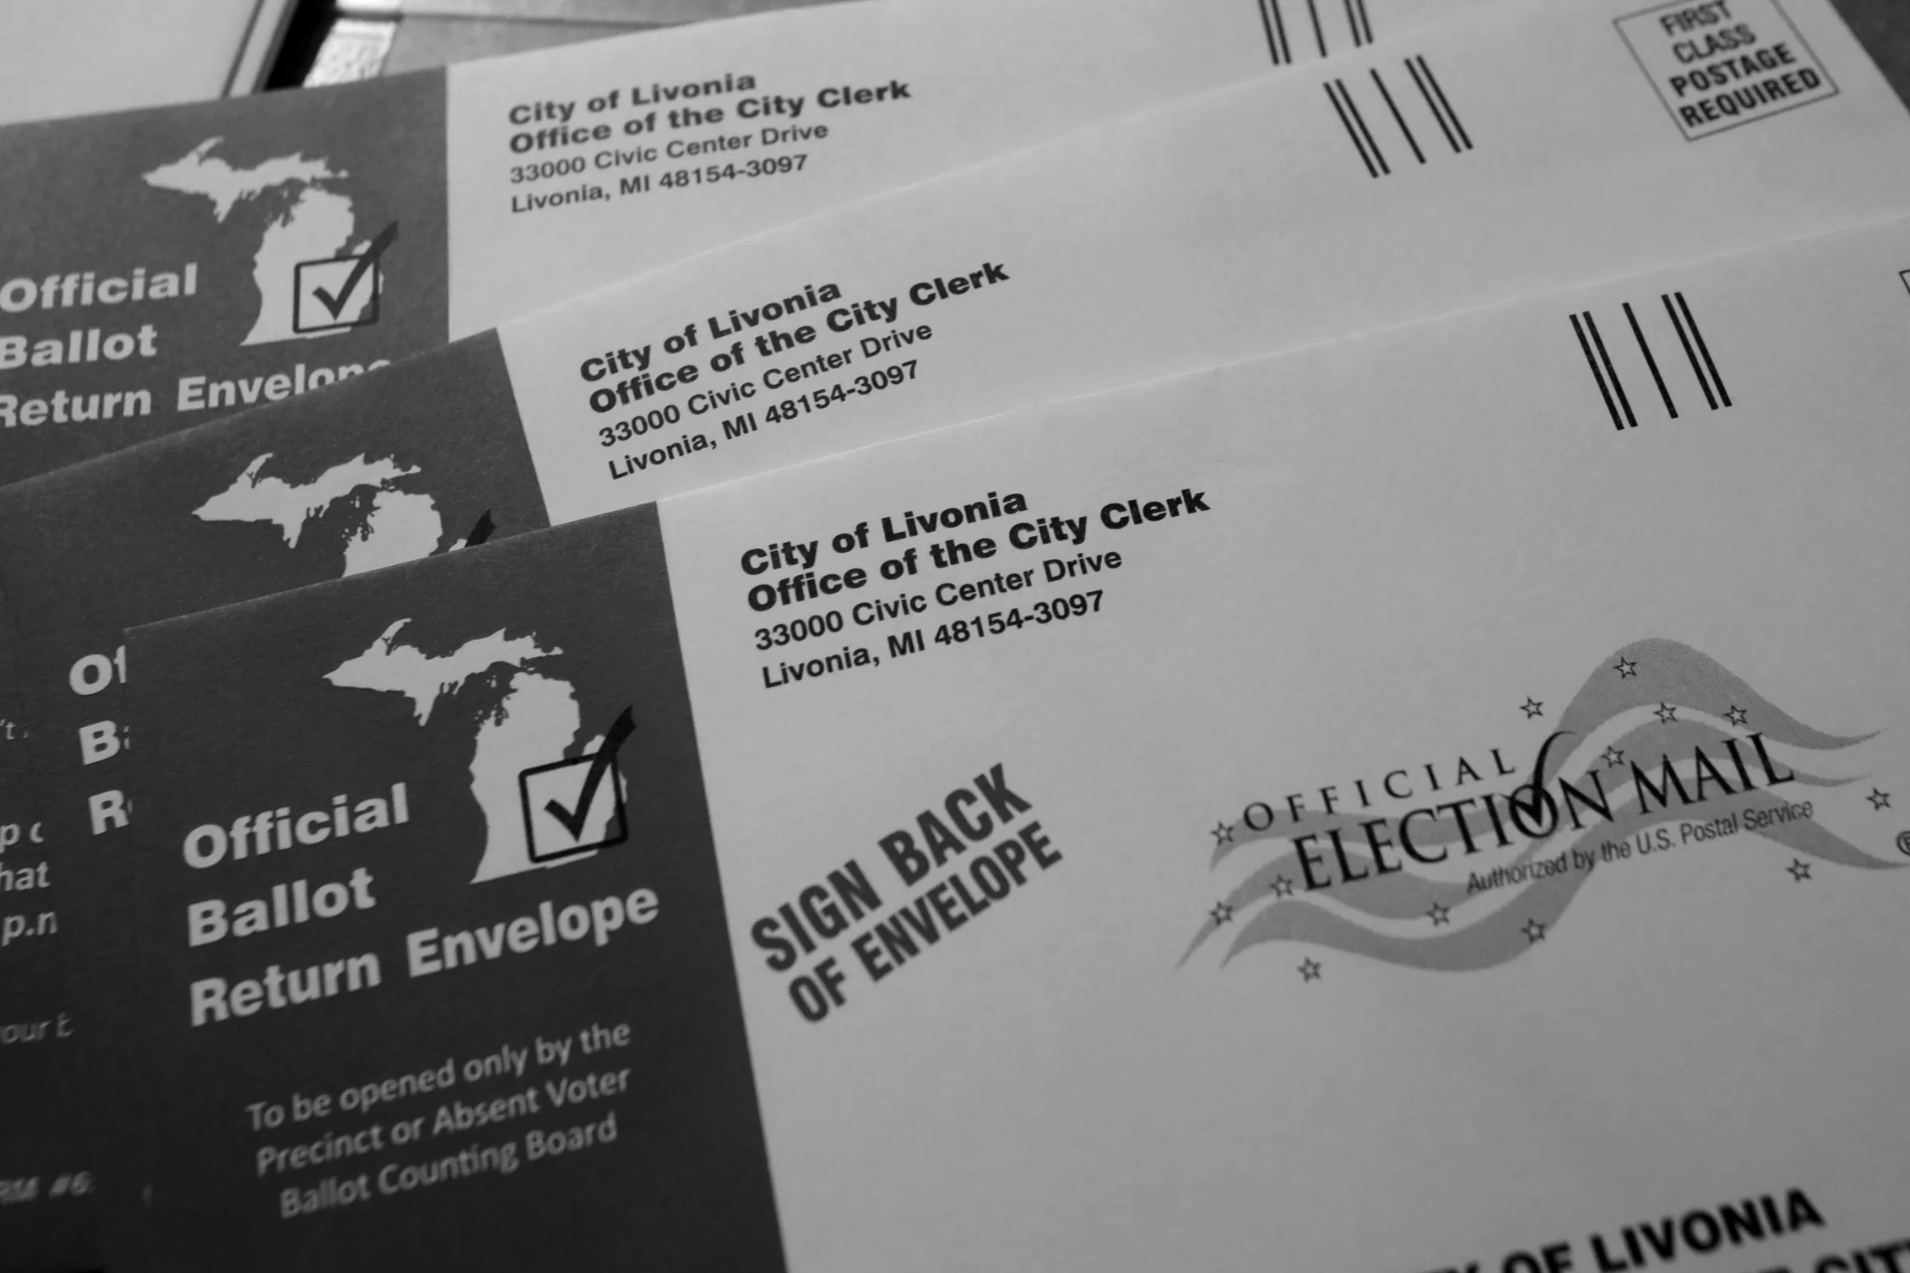
Policy Recommendation
Implement Independent Redistricting
Independent (non-partisan) selection process for commissioners
Adopt Inclusive Voter Policies
Automatic Voter Registration
Universal Mail-In Voting
Extending Early Voting
Notes:
Graphic from: https://uspirg.org/blogs/blog/usp/one-graphic-explains-automatic-voter-registration-0

Slide 8
Acknowledgements
We would like to thank E-Board for their help throughout the semester.
Thank you everyone for coming!

Slide 9
Works Cited
Capitol Broadcasting Company, “Editorial: Voters to legislators. Stop fighting governor. Cooperate and compromise.”, WRAL. com, November 12, 2020. https://www.wral.com/coronavirus/editorial-voters-to-legislators-stop-fighting-governor-cooperate-and-compromise/19381587/
Dave Bradlee. “NC 2018 Lower House.” Dave’s Redistricting. https://davesredistricting.org/maps#analytics::241341aa-3e2b-4648-bf91-ec993801d541
“Data Note: 5 Charts About Public Opinion on Medicaid.” KFF. February 28, 2020. https://www.kff.org/medicaid/poll-finding/data-note-5-charts-about-public-opinion-on-medicaid/
Alex Tausanovitch and Emily Gee, “How Partisan Gerrymandering Limits Access to Health Care”, Center for American Progress, February 24, 2020, https://www.americanprogress.org/issues/democracy/reports/2020/02/24/480684/partisan-gerrymandering-limits-access-health-care/
Collin Mathis, Daniel Moskowitz, and Benjamin Schneer, “The Arizona Independent Redistricting Commission: One State’s Model for Gerrymandering Reform”, Harvard Kennedy School: Ash Center for Democratic Governance and Innovation, September 2019, https://ash.harvard.edu/files/ash/files/az_redistricting_policy_brief.pdf
Collin Mathis, Daniel Moskowitz, and Benjamin Schneer, “The Arizona Independent Redistricting Commission: One State’s Model for Gerrymandering Reform”, Harvard Kennedy School: Ash Center for Democratic Governance and Innovation, September 2019, https://ash.harvard.edu/files/ash/files/az_redistricting_policy_brief.pdf
Michael Latner, “Our Unhealthy Democracy”, The Union of Concerned Scientists, November 2019, https://www.ucsusa.org/sites/default/files/2019-10/our-unhealthy-democracy-white-paper-2019.pdf
“Automatic Voter Registration, A Summary”, Brennan Center for Justice, July 2019, https://www.brennancenter.org/our-work/research-reports/automatic-voter-registration-summary
Drew Desilver, “U.S. Trails Most Developed Countries in Voter Turnout”, Pew Research Center, May 2017 https://static1.squarespace.com/static/58706fbb29687f06dd219990/t/5b108a8d70a6ad1221aa63c1/1527810701921/U.S+voter+turnout+lower+than+most+countries+-+Pew+May+2017.pdf
Ruth Greenwood, Annabelle Harless, Blair Bowie, and Charquira Wright, “Designing Independent Redistricting Commissions”, Campaign Legal Center. https://campaignlegal.org/sites/default/files/2018-07/Designing_IRC_Report2_FINAL_Print.pdf
“Redistricting Commissions: What Works”, Brennan Center for Justice at New York University School of Law. https://www.brennancenter.org/sites/default/files/analysis/Redistricting%20Commissions%20-%20What%20Works.pdf

