Slide 1
Addressing South Carolina’s Rural Healthcare Crisis
Megan Shohfi, Alexa Samani, Aaron Meyer

Slide 2
AGENDA
Background
Option #1
Option #2
Option #3
Recommendation
Acknowledgments
Notes:
To give you an idea of what we will be covering today, we will first discuss the background of this issue, then three possible policy solutions to addressing the rural healthcare crisis in South Carolina, and lastly, our recommendation on which policy option will most effectively mitigate this problem.

Slide 3
1.
Background
On rural health disparities in South Carolina
Notes:
First, we will give a brief background of the rural health disparities in the US and South Carolina.

Slide 4
120 ; 453
Closed Rural Hospitals ; Vulnerable Facilities
Notes:
As of 2020, this rural hospital closure crisis has closed over 120 facilities across the nation, and 453 additional rural hospitals are vulnerable to closure based on performance levels which are similar to former rural hospitals at the time of their closure (Estes). Rural Americans are facing a healthcare crisis that needs policy attention. Since 2014, states have had the option to expand Medicaid within their borders. However, over the last seven years, twelve states have yet to adopt this expansion. Combining the lack of low-income medical care coverage has meant many rural hospitals in these states are victims of market forces which leave hospitals with millions of dollars of unpaid medical expenses.

Slide 5
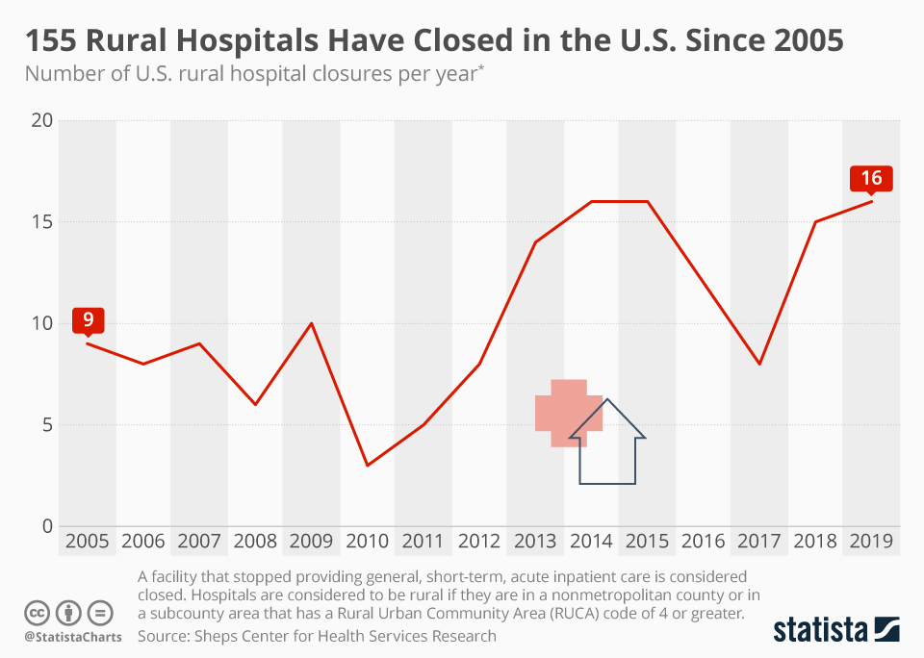
One in five Americans live in rural areas and depend on their local hospitals for care.
Last year, 20 of those hospitals closed, making 2020 a record year for rural hospital closures.
States which have not expanded their Medicaid coverage are experiencing the highest levels of closures.
Rural Americans are “more likely to die from heart disease, cancer, unintentional injury, chronic lower respiratory disease, and stroke than their urban counterparts” (CDC).
South Carolina: 25% of the state’s population lives in rural communities, “half of the excess deaths in the state occur in these rural areas.”
Notes:
About 60 million people — nearly one in five Americans — live in rural areas and depend on their local hospitals for care. Last year, 20 of those hospitals closed, making 2020 a record year for rural hospital closures.
States which have not expanded their Medicaid coverage are experiencing the highest levels of closures.
Rural Americans are “more likely to die from heart disease, cancer, unintentional injury, chronic lower respiratory disease, and stroke than their urban counterparts” (CDC).
South Carolina: 25% of the state’s population lives in rural communities, “half of the excess deaths in the state occur in these rural areas.”

Slide 6
Option #1
Incentivizing privatization of healthcare in rural areas
Notes:
One way to address this issue is by incentivizing the privatization of healthcare in rural areas.

Slide 7
Incentivizing Health Care Privatization: Hedging Risk
Insurers are Risk Averse Agents
Physicians need around 2,300 patients in their care to help pay their salaries, an often unreachable number in rural counties
Increase the Pool of Risk
If a larger portion of individuals are covered by insurance, insurance providers are financially incentivized to stay in rural markets
Consolidating Rating Areas
By mandating the consolidation of rural insurance rating areas with nearby urban areas, premiums can be lowered, encouraging health insurance.
Notes:
First, I will cover how insurance premiums are decided. Under the Affordable Care Act, premiums must be solely determined by an individual’s smoking status, age, and area of residence. As Meg alluded to earlier, rural americans are far more likely to fall victim to chronic diseases and injuries, which mean insurance premiums in so called rural ‘rating areas’ are significantly higher. Thus, insurance rates, for this reason and many others, are significantly lower in rural areas. On average, physicians need about 2,300 patients to help cover their salary, and since insurers are risk averse agents- insurance in these areas can be unattainable. However, using a common private market tactic of hedging risk and increasing risk pools, we can incentivize higher insurance coverage. Combining rating areas of rural areas with nearby urban rating areas, risk pools are larger, and less risky- creating cheaper premiums since populations have entered the rating area that are less likely to cause financial losses for insurers. By increasing insurance rates in rural regions, hospitals can stay open without fear of drastic financial loss

Slide 8
Option #2
Rural Emergency Acute Care Hospital (REACH) Act
Notes:
Another policy approach to mitigating the effects of the rural healthcare crisis in South Carolina is through implementing the Rural Emergency Acute Care Hospital Act, also known as the REACH Act.

Slide 9
Rural Emergency Hospitals (REH) receive Medicare funding to avoid shutting down
Small rural hospitals to convert to rural emergency hospitals (REH)
Allow medical facilities that are not hospitals to provide emergency care, all funded by Medicare
Leads to increased and more affordable access to hospitals for South Carolinians
Notes:
The REACH Act would provide “support for cost-efficient rural hospitals and allow medical facilities that are not hospitals to provide emergency care, all funded by Medicare” (Jaime Harrison for Senate). This policy revises provisions to hospitals in rural areas by allowing certain small hospitals to be identified as Rural Emergency Hospitals (REH) and receive Medicare funding to avoid shutting down. This policy would allow small rural hospitals converted to rural emergency hospitals that can continue providing necessary emergency and observation services (at enhanced reimbursement rates), but stop inpatient services (AHA). By allowing small rural hospitals to convert to REHs at enhanced reimbursement rates covered by Medicare, rural South Carolinians will have increased and more affordable access to hospitals which is essential as South Carolina’s rural counties have worse health outcomes than the rest of the state. One potential cost of this legislation is the new classification for REHs still would not allow these hospitals to provide inpatient services (AHA). This cost burdens rural community members relying on these hospitals for injuries and illness and healthcare workers in these hospitals. However, this legislation proposes Medicare reimbursement rates that would cover the cost of transportation to and from hospitals that provide inpatient services (AHA).

Slide 10
Option #3
Expanding Telehealth Opportunities in Rural Areas
Notes:
One final approach to mitigate this issue is to expand telehealth opportunities in rural areas.

Slide 11
Expanding Telehealth Opportunities
Benefits:
Easy access to medical specialists & professional screening of chronic conditions without need to travel
Beneficial during pandemic & to those at high risk for COVID-19
Drawbacks:
Residents of poorer socioeconomic backgrounds have lower rates of internet access
Cannot replace emergency medical services
Notes:
Telehealth services can be very beneficial by providing many essential health services to patients inside their homes. Telehealth services give rural South Carolinians access to more medical specialists, professional screening of chronic conditions, such as obesity, high blood pressure, and mental health conditions. Telehealth’s popularity has grown much due to the pandemic. Expanding rural Telehealth may be supported by rural hospital administrators who have been subject to economic losses, internet service providers, and urban physicians who may be able to expand their patient intake.
However, across rural America, residents are often of poorer socioeconomic classes and have significantly lower rates of broadband internet access. One in four rural houses lacks reliable internet to use Telehealth services, and even more, households lack the necessary equipment, like a computer camera. Additionally, Telehealth services cannot be used as a complete replacement for emergency medical services, which still must be provided by in-patient hospitals.

Slide 12
Recommendation
Implementing the REACH Act is the best option for South Carolina legislators to curb the negative effects of rural health disparities due to the closure of rural hospitals.
Notes:
After careful consideration, we have determined that Implementing the REACH Act is the best option for South Carolina legislators.
The REACH Act provides rural Americans the opportunity to receive quality healthcare covered by Medicaid within a manageable radius of their home. Though there are drawbacks to the REACH act, these issues have a greater chance of being addressed.
Telehealth services have been reliable during the pandemic especially, however expanding these services to rural areas does not provide a solution to emergency medical situations.
Additionally, while there are ways to Incentivise private healthcare organizations to provide insurance to people living in rural areas, however, there is no guarantee that private businesses will want to move into the market. Additionally, it may raise premiums for urban communities.

Slide 13
REACH Act
Implementing the REACH Act could save the lives of rural Americans.
Notes:
While One potential cost of this legislation is the new classification for REHs still would not allow these hospitals to provide inpatient services (AHA), this legislation proposes Medicare reimbursement rates that would cover the cost of transportation to and from hospitals that provide inpatient services (AHA). Therefore, investing in rural hospitals through the REACH Act will revitalize rural South Carolina by reducing health care disparities which will allow more people to live and work more healthy.

Slide 14
Any Questions?
Thank you!
Notes:
Thank you so much for your time and attention, we hope our presentation has shed light on an important issue impacting many rural americans and possible policy solutions.

