Slide 1
Voter Disenfranchisement in Alabama
Kate Weiland and Talia Potters

Slide 2
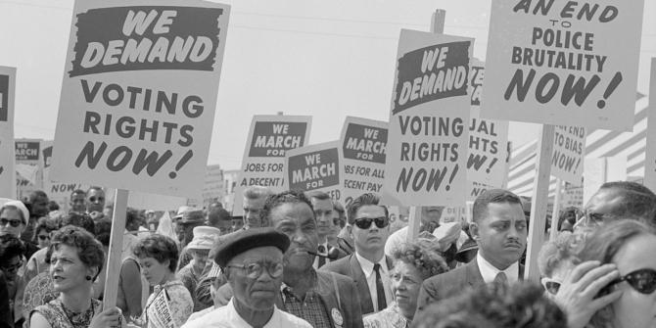
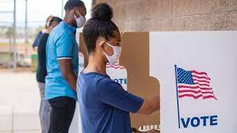
Background
Background
- Black communities have been especially hard hit by voter suppression
- Historically practiced with Jim Crow laws
- During Covid-19 there were safety issues with going to vote in person
- Voter disenfranchisement is a direct way that politicians attempt to influence the outcome of elections

Slide 3
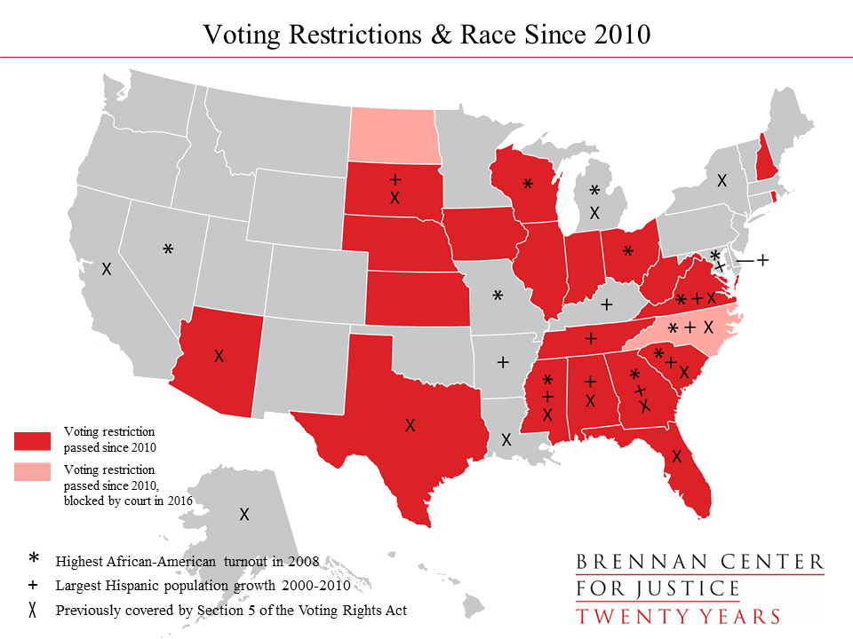
Why Alabama?
- One of only eleven states that do not have early voting
- One of eleven states that requires voters to have two witnesses or notary to sign off on absentee ballots
- Voters did not automatically receive a mail-in ballot despite the pandemic, but instead had to request a mail-in ballot application
- Required to provide photo ID to vote, many of which are obtained from motor vehicle offices
Notes:
Alabama has historically struggled with voter disenfranchisement, especially in underrepresented communities, and many officials have continued to impose and defend voter restrictions over the past few years.

Slide 4
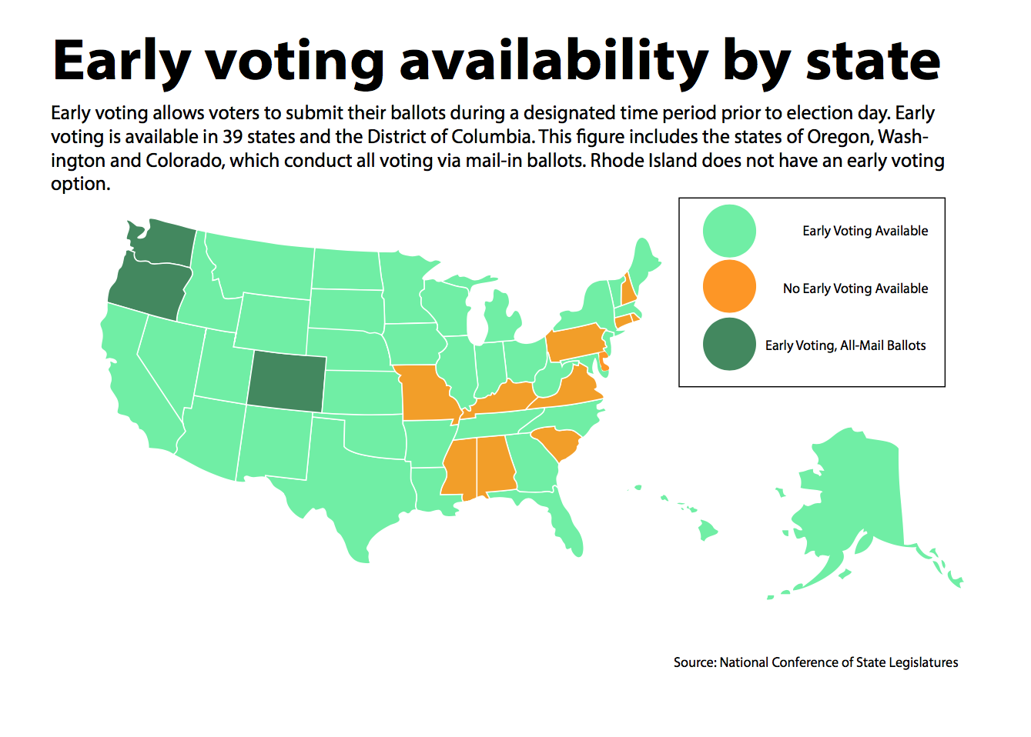
Option 1: Legalizing Early Voting in Alabama
Pros of Early Voting
De-densify the polls making voting during COVID-19 safer
Black communities often prefer to vote in person rather than by mail
Organizations like Souls to the Polls would utilize it with their Black congregants
Cons of Early Voting
COVID-19 caused nationwide poll closings, so in-person poll locations may be far and inaccessible

Slide 5
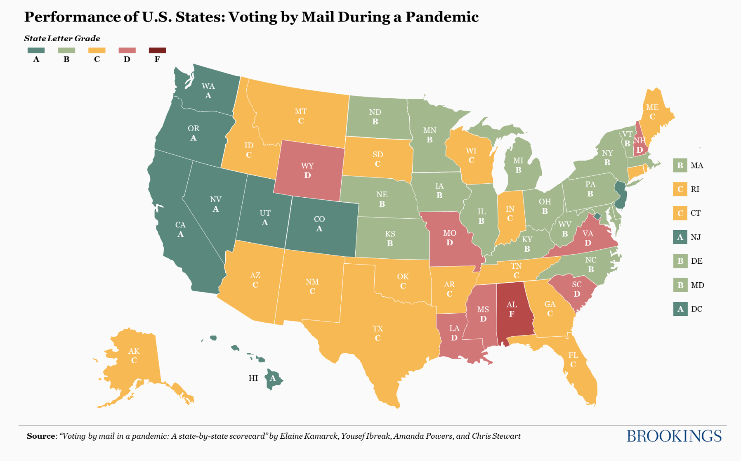
Option 2: Allowing for No Excuse Absentee Voting with No Restrictions
Barriers in previous elections that this would address:
Banks were closed due to the pandemic and many low income individuals are unable to get a notary for their ballot
Absence of dropboxes for returning an absentee ballot
Cons of no excuse absentee voting:
Voters may make mistakes when filling out their ballots
No ballot curing process

Slide 6
Recommendation: Legalize Early Voting
WHY?
More people will be able to vote at a time that is convenient for them
This policy would allow for de-densification of the polls, making it safer for people to vote
Almost 100 million Americans voted early in the 2020 presidential election, so it is clearly an effective improvement.
Most states already utilize early voting as it is proven to increase voter turnout, especially for disenfranchised communities
75% of voters support early voting
HOW?
Available at least 2 weeks before election day, including weekends and post-work hours
Based on expansion estimates, it will likely cost $1 million per county to expand early voting, but this expense is worth it

Slide 7
Credit
We would like to thank Sylvia Albert, Katie Chan, and Laura Williamson for meeting with us this semester and providing a professional, informed perspective on our topic!
We would also like to thank SFD eboard for all of the work they put into this club this semester and allowing us the opportunity to participate in this research!

Slide 8
Thank You!

Slide 9
References
Ibreak, Yousef, Kamarck, Elaine, Powers, Amanda, and Stewart, Chris. “Voting by mail in a pandemic: A state-by-state scorecard”, Brookings, 2020. https://www.brookings.edu/research/voting-by-mail-in-a-pandemic-a-state-by-state-scorecard/.
“Federal Court Says ID, Witnesses Required for Absentee Voting”, Birmingham Watch, 2020. https://birminghamwatch.org/federal-court-says-id-witnesses-required-absentee-voting/.
Seale, Michael. “Alambama is 2020’s 5th Least Educated State in U.S.: Report”, Patch, 2020. https://patch.com/alabama/across-al/alabama-2020-s-5th-least-educated-state-u-s-report.
Holmes, Allan. “In Alabama, A Long History of Suppressing Black Votes Continues”, The Center for Public Integrity, 2020. https://publicintegrity.org/politics/elections/us-polling-places/alabama-long-history-of-suppressing-black-voting-continues/.
Astor, Maggie. “Seven Ways Alabama Has Made It Harder to Vote”. New York Times, 2020. https://www.npr.org/2020/10/19/924705412/race-for-a-ballot-cure-the-scramble-to-fix-minor-absentee-ballot-problems.
Fessler, Pam. “Race For A (Ballot) Cure: The Scramble To Fix Absentee-Ballot Problems”. NPR, 2020. https://www.npr.org/2020/10/19/924705412/race-for-a-ballot-cure-the-scramble-to-fix-minor-absentee-ballot-problems.
Kennedy, Liz and Root, Danielle. “Increasing Voter Participation in America”. Center for American Progress, 2018. https://www.americanprogress.org/issues/democracy/reports/2018/07/11/453319/increasing-voter-participation-america/.
Blasi, Weston. “Over 100 million Americans voted early in the 2020 election”. MarketWatch, 2020. https://www.marketwatch.com/story/early-voting-breaks-record-as-more-than-60-million-americans-already-cast-their-ballots-11603735298.
Vaughan, Dawn. “Black voter turnout could swing the election in North Carolina”. The News & Observer, 2020. https://www.newsobserver.com/news/politics-government/election/article246665390.html.
“Expand Early Voting.” Brennan Center for Justice, 4 February 2016, https://www.brennancenter.org/our-work/research-reports/expand-early-voting

