Slide 1
Maximizing Voter Turnout Through Covid-19 Era Policies
Group 6: Talia Rubin, Kevin Bruey, Jacob Berch, Aneesa Berner

Slide 2
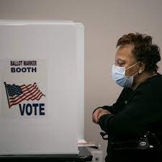
Overview
Covid-19 as a threat to voter turnout
Led to state changes in voting procedures
Promoting health and civic duty simultaneously
Success in increasing voter turnout
Benefits of continuing these policies post-pandemic
Extended mail-in voting
Extended in-person voting
Online voting

Slide 3
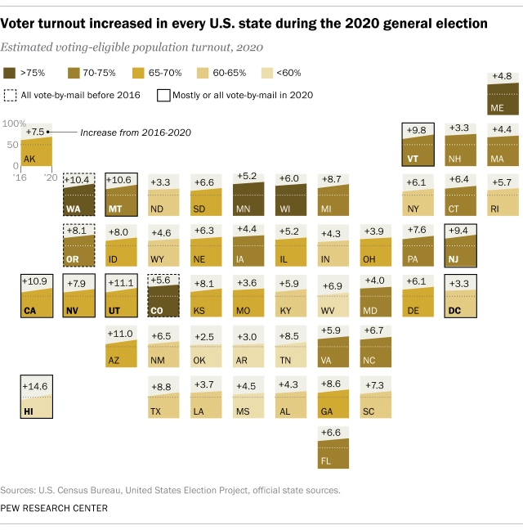
Background
35 states made changes to their voting systems in 2020
Increasing mail-in voting opportunities or extending in person opportunities
Threats to these changes
At least 106 bills introduced in 28 state legislatures, “more than a third… seek[ing] to limit mail voting”
These proposals “circumscribe who can vote by mail, make it harder to obtain mail ballots, and impose hurdles to complete and cast mail ballots”

Slide 4
Policy Option #1: Automatic mail-in ballot system
Advantages:
Contact-free
Potential for other election administration benefits
Disadvantages:
Concerns re: secret ballot
Notable political opposition post-2020
All eligible voters are automatically mailed ballots
Returnable through mail & at drop-off sites
In-person voting retained on Election Day
Permanently utilized in 5 states
Temporarily adopted by 4 others

Slide 5
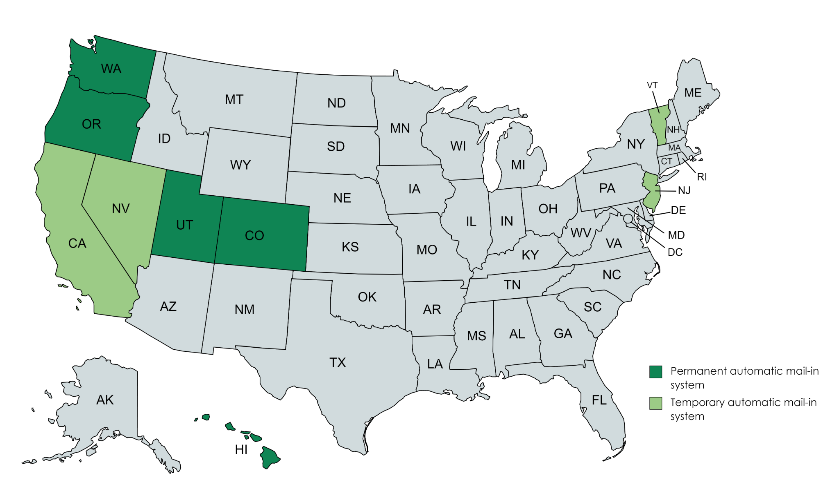

Slide 6
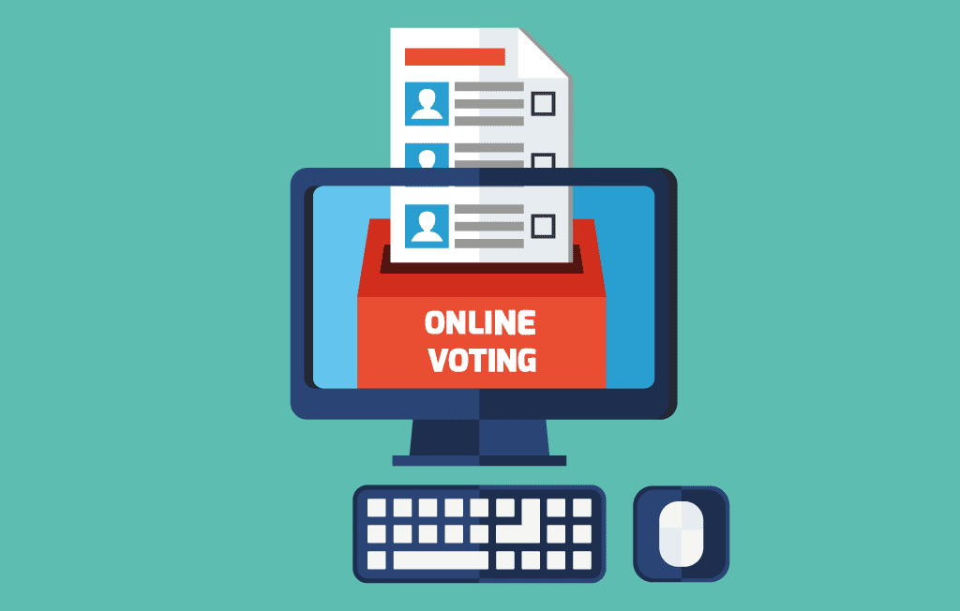
Policy Option #2: Online voting
Currently an option for those serving/living overseas
Advantages
Providing a safe way for the vulnerable to safely vote
Offered in conjunction with other means of voting in 32 states
Greater access to the polls
Reduce lines
Disadvantages
Confidentiality
Security

Slide 7
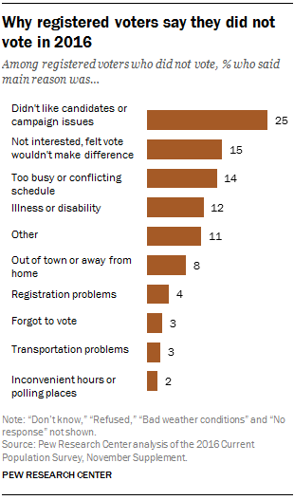
Policy Option #3: Extended early in-person voting
More opportunities to vote in person as 14% of people cite “too busy or conflicting schedule” as reason for not voting in 2016.
Advantages:
Reduced Stress
Shorter Lines
Greater Access to Voting
Disadvantages:
In person options means still a risk of potential exposure to illness
Increased Cost: 37 Million USD (Brennan Center)

Slide 8
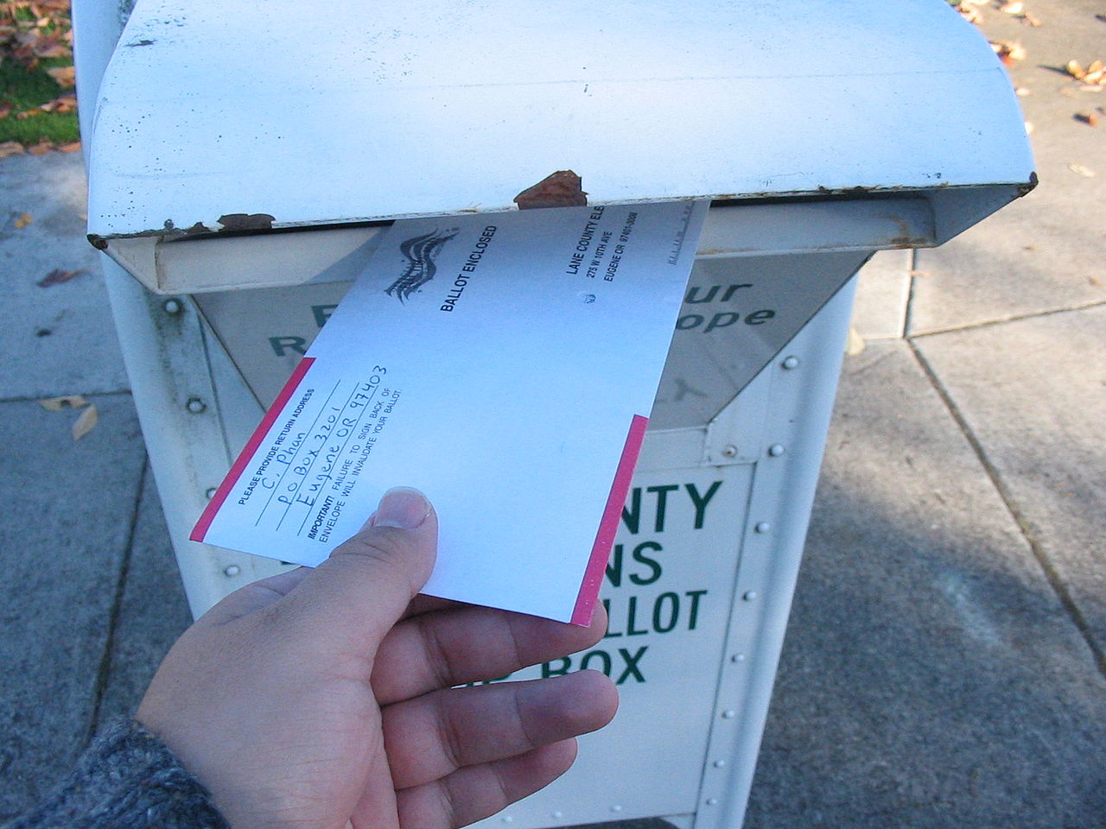
Recommendation: Automatic mail-in ballot system
Most accessible of three options
No transportation required
No Internet access required
Completely contact-free
Myriad of election administration benefits
Reduced costs
Reduced no. of provisional ballots
High voter satisfaction
No evidence of significant issues re: fraud

Slide 9
Acknowledgement
Thank you to E-Board for a great semester!

Slide 10
Sources
212, 7871, 202, 7844, and 192. "Estimated Costs of Covid-19 Election Resiliency Measures." Brennan Center for Justice. Accessed April 14, 2021. https://www.brennancenter.org/our-work/research-reports/estimated-costs-covid-19-election-resiliency-measures.
López, Gustavo, and Antonio Flores. "Why Registered Voters Say They Didn't Vote in 2016." Pew Research Center. July 28, 2020. Accessed April 14, 2021. https://www.pewresearch.org/fact-tank/2017/06/01/dislike-of-candidates-or-campaign-issues-was-most-common-reason-for-not-voting-in-2016/.
Sweren-Becker, Eliza. “Voting During Covid-19,” 2020. https://www.brennancenter.org/our-work/research-reports/voting- during-covid-19.
DeSilver, Drew. “Turnout Soared in 2020 as Nearly Two-Thirds of Eligible U.S. Voters Cast Ballots for President.” Pew Research Center. Pew Research Center, January 28, 2021. https://www.pewresearch.org/fact-tank/2021/01/28/ turnout-soared-in-2020-as-nearly-two-thirds-of-eligible-u-s-voters-cast-ballots-for-president/.

Slide 11
Sources, cont.
“Absentee and Mail Voting Policies in Effect for the 2020 Election.” National Conference of State Legislatures, November 3, 2020. https://www.ncsl.org/research/elections-and-campaigns /absentee-and-mail-voting-policies-in-effect-for-the-2020-election.aspx.
“Colorado Voting Reforms: Early Results.” The Pew Charitable Trusts, March 2016. https://www. pewtrusts.org/~/media/assets/2016/03/coloradovotingreformsearlyresults.pdf.
Lee, Nathaniel. “Here's Why Most Americans Are Not Able to Vote Online in 2020.” CNBC, September 23, 2020. https://www.cnbc.com/2020/09/23/why-us-cant-vote-online-in-2020-presidential- election-trump-biden.html.

